Slide 1





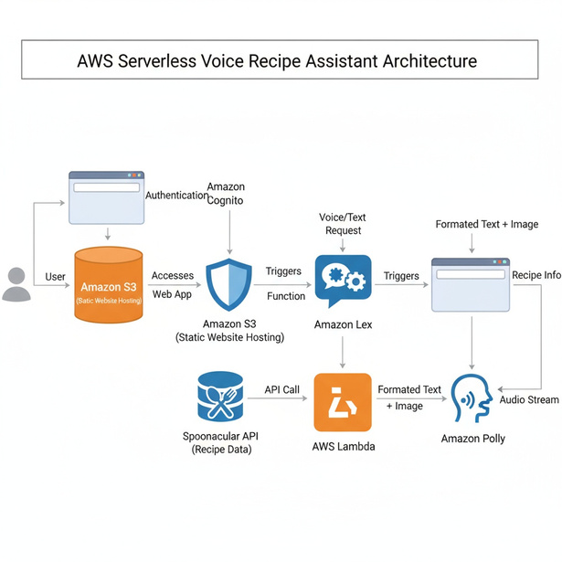

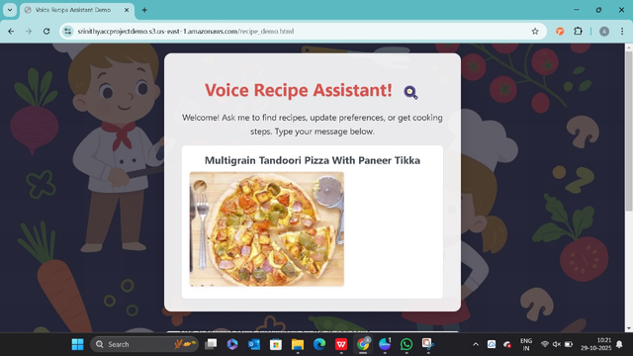
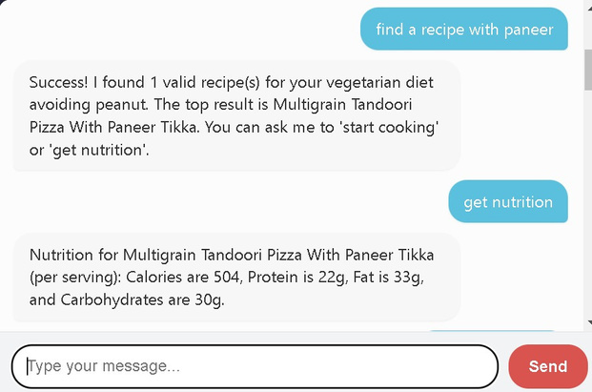



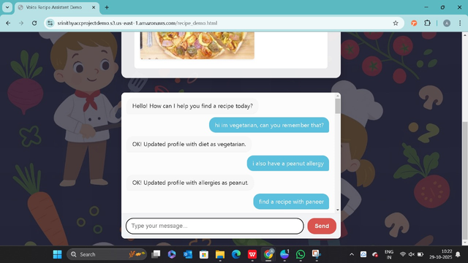

AWS Serverless Voice Recipe Assistant
Name of the Student: Akula Srinithya, SAP ID:705722400013
Name of the Supervisor: Dr.Naresh Vurukonda
Department of CSE Data Science, Hyderabad Campus
Introduction
Architecture, Flowchart, Models, Results
Conclusion
About the Project
The Voice Recipe Assistant is a modern, serverless web application designed to simulate a conversational AI kitchen helper. The system leverages a powerful combination of AWS services to create an intelligent and interactive user experience. At its core, the project uses Amazon Lex V2 for Natural Language Understanding (NLU), allowing it to interpret user requests for recipes, ingredients, or cooking steps. It uses Amazon Polly to convert the bot's text-based answers into natural, lifelike speech, making the application accessible and hands-free. The entire application is serverless, with the frontend hosted on Amazon S3, backend logic on AWS Lambda, and security managed by Amazon Cognito and IAM
Architecture Flow chart
Workflow Description:The user accesses the web app hosted on Amazon S3 and authenticates via Amazon Cognito. They send a text request, which Amazon Lex processes. Lex invokes an AWS Lambda function, which then queries the Spoonacular API for the recipe data. Lambda formats this data (title, image, steps) and returns it to Lex, which sends it to the web app for display. Simultaneously, the text response is sent to Amazon Polly, which synthesizes it into an audio stream for the user to hear
Discussion/Conclusion
This project successfully demonstrates the power of "stitching together" multiple managed services to create a complex, intelligent, and feature-rich application. By integrating Amazon Lex for conversational AI, Amazon Polly for voice, AWS Lambda for logic, and the Spoonacular API for data, we built a "Voice Recipe Assistant" that is both highly functional and user-friendly. The serverless architecture proves to be the ideal model for this application, offering immense scalability, low operational overhead, and a cost-effective pay-per-use model..
Future Scope
Results
Full Voice-to-Voice: Integrating Amazon Transcribe to convert the user's spoken words into text, for a truly hands-free experience.
User Profiles & Favorites: Using Amazon DynamoDB to store user profiles, allowing them to save favorite recipes or set permanent dietary preferences.
Step-by-Step Cooking Mode: Enhancing the Lex bot and Lambda function to guide a user through a recipe one step at a time.
Objective of the Project
TThe primary objective of this project is to build a web-based, voice-enabled conversational assistant using AWS services. The goal is to allow users to input text and receive a helpful, context-aware audio-visual response in real-time, ensuring a smooth, scalable, and intelligent serverless experience
References and Affiliations
Methods
References
  Spoonacular API Documentation: https://spoonacular.com/food-api/docs
  Amazon Lex V2 Developer Guide: https://docs.aws.amazon.com/lexv2/latest/dg/what-is.html
  Amazon Polly Developer Guide: https://docs.aws.amazon.com/polly/latest/dg/what-is.html
  AWS Lambda Developer Guide: https://docs.aws.amazon.com/lambda/latest/dg/welcome.html
  Amazon Cognito Developer Guide: https://docs.aws.amazon.com/cognito/latest/developerguide/what-is-amazon-cognito.html
  Amazon S3 User Guide (Static Hosting): https://docs.aws.amazon.com/s3/latest/userguide/WebsiteHosting.html
Methods and Services
The Project integrates several key AWS services and a third-party API to function:
Amazon lex V2:
provides Language Understanding (NLU) to identify user intent
AWS Lambda:
The serverless backend "brain" that runs the code to fulfill the Lex intent, call the Spoonacular API, and process the results.
Amazon Polly:
Provides Text-to-Speech (TTS) synthesis, converting the bot's text replies into a playable, lifelike audio voice.
Spoonacular API:
The third-party data source that provides all recipe data, including titles, instructions, and image URLs, via HTTP requests.
Amazon S3:
Used for cloud storage to host the static website (HTML, CSS, JavaScript files) and make it accessible to the public internet.
Amazon Cognito:
Manages security by providing secure, temporary AWS credentials to the frontend application so it can access Lex and Polly without exposing secret keys.
IAM Roles:
Grants specific permissions for all the services to communicate with each other securely (e.g., allowing Lex to invoke Lambda)
Acknowledgement
I sincerely thank Dr. Naresh Vurukonda for his
valuable guidance and support throughout this project ,
carried out as a part of Cloud Computing
course.
Project Demo Link
https://youtu.be/i89wo1gTGls
Document of project implementation link:
https://drive.google.com/file/d/15-Hn1K2jXpSkMRngd5grTi69ZdcN0rvU/view?usp=sharing

